Slide 1


Faculty of Information engineering, Informatics and Statistics, Engineering in computer science, University of Rome Sapienza, Academic year 2022-2023 Andrea Panceri 1884749 Francesco Sudoso 1808353
Project type 1 of Data Management
Schedule Checker for concurrency control
Prof. Maurizio Lenzerini
Tutor Roberto Delfino
Prof. Giovanni Farina
Notes:
‹#›

Slide 2
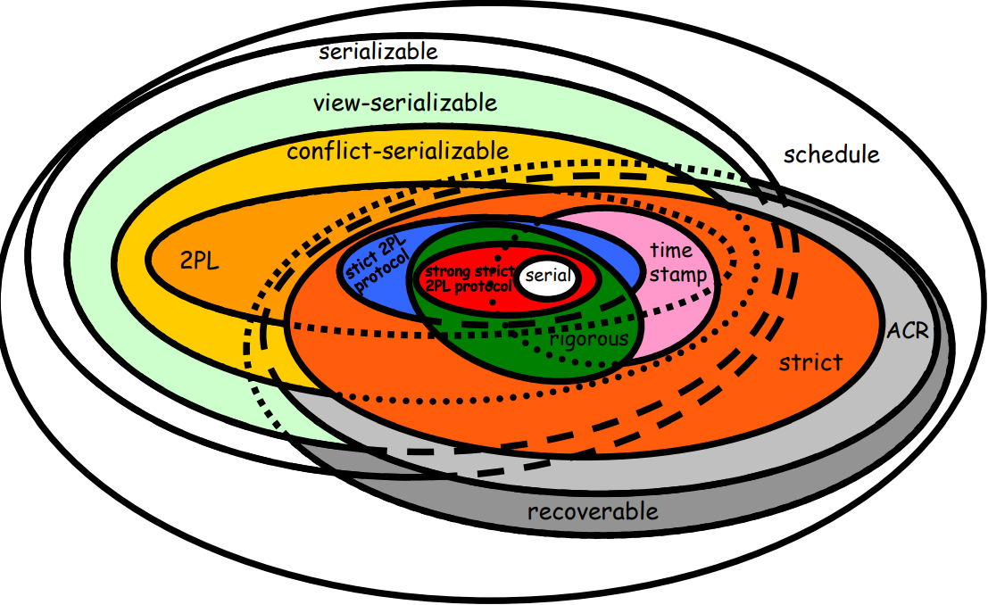
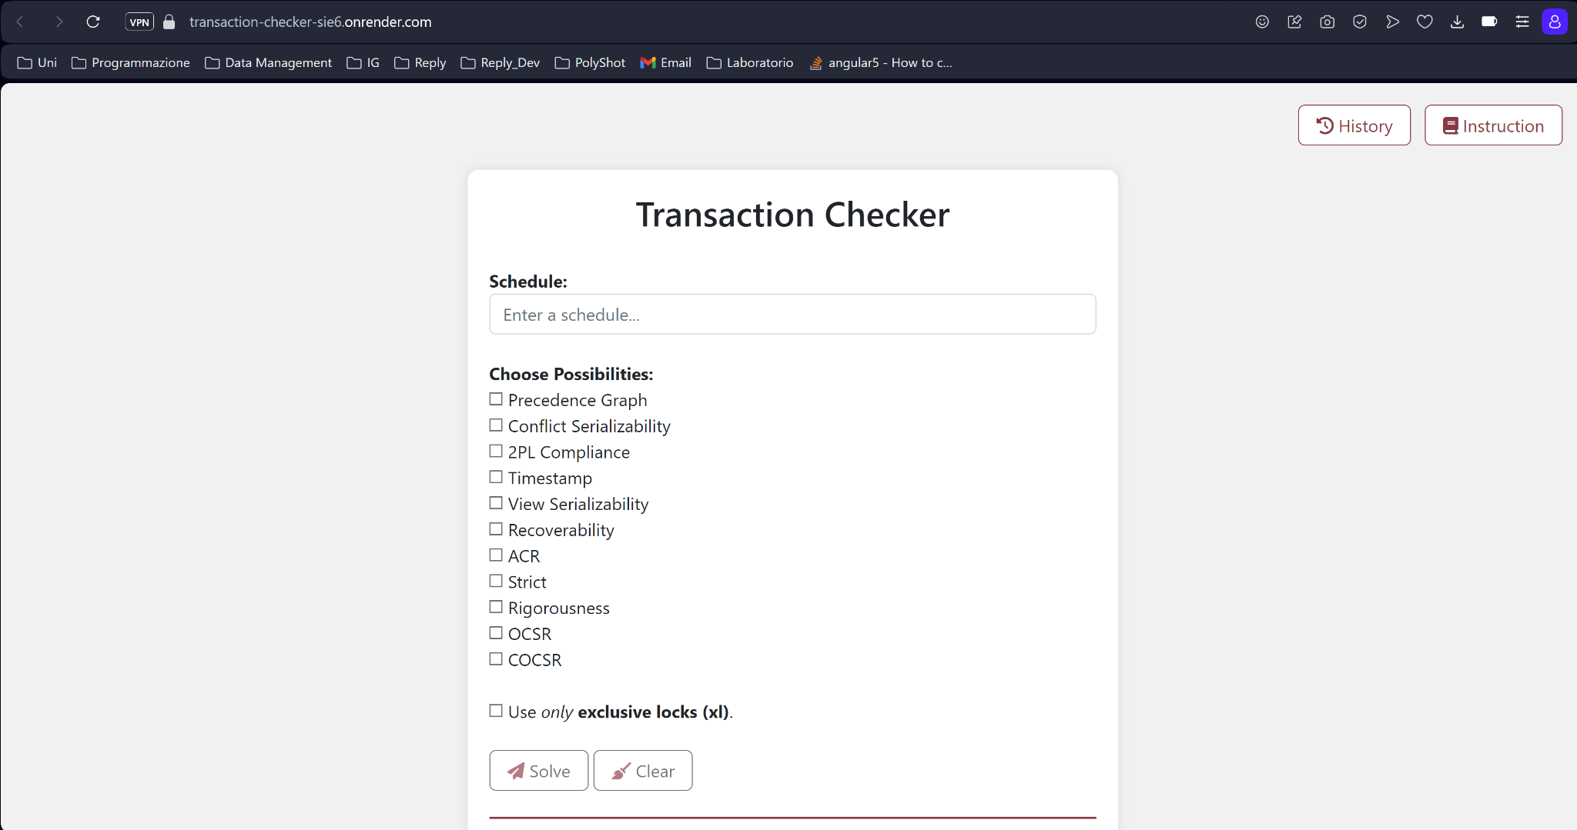
Overview Project
Our project is a web application that taking a schedule in input, will check if it falls in any of the classes of schedules that we seen at course of Data Management.
We develop an algorithm for all class of schedules.

Slide 3



Frameworks used
Several frameworks and libraries were used in the development of our application.
Bootstrap
Flask
D3.js

Slide 4
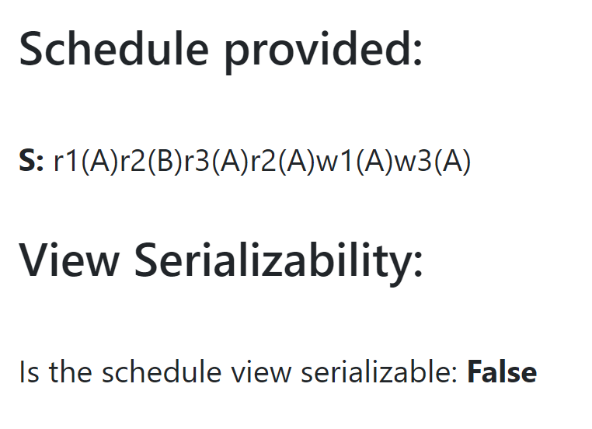
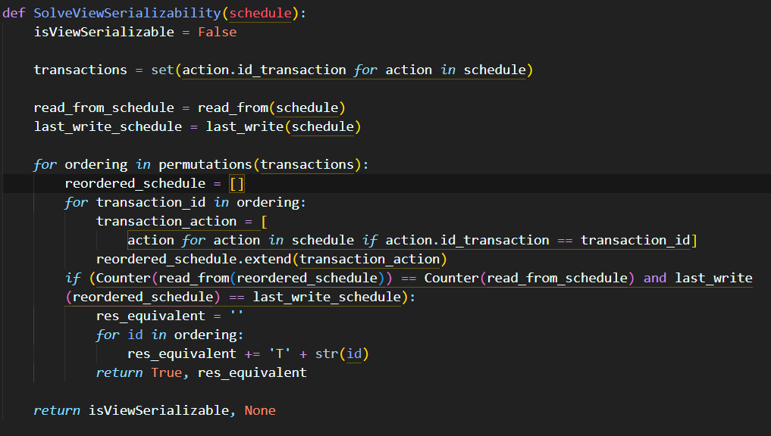
Checker for View Serializability
Definition of view-serializability:
A (total) schedule S on {T1,…,Tn} is view-serializable if there exists a serial schedule S’ on {T1,…,Tn} that is view-equivalent to S.
Algorithm:
1 - Calculate all possible serial schedule given the set of transactions.
2 - Check if exist a serial schedule that has same read-from and final write set of given schedule.
3 - If exist then return True, otherwise check all possible serial schedule and return False.

Slide 5
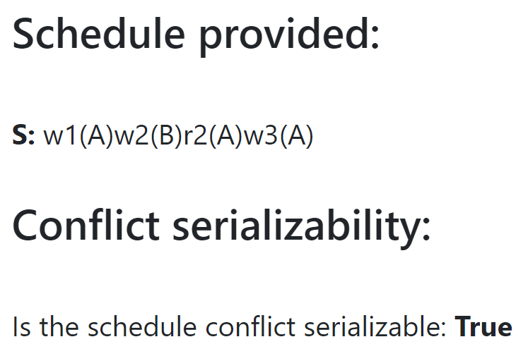
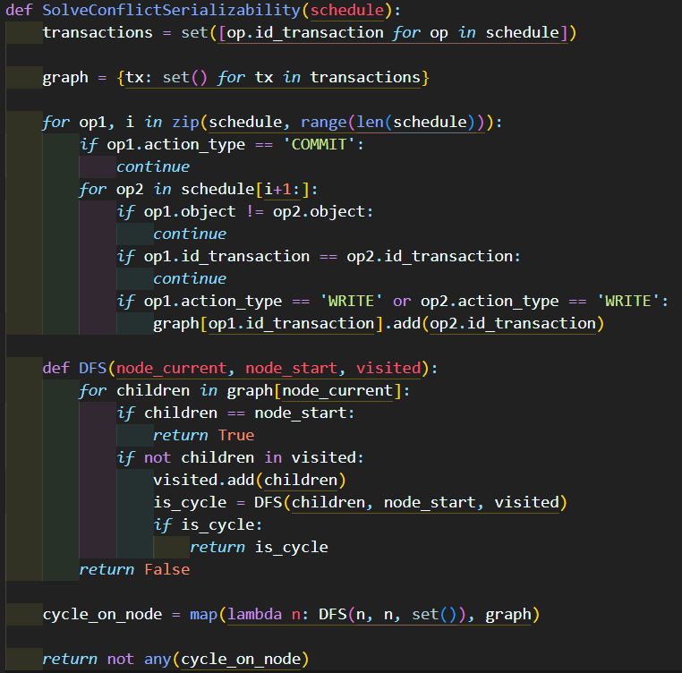
Checker for Conflict Serializability
Definition of conflict-serializability:
A schedule S is conflict-serializable if there exists a serial schedule S’ that is conflict-equivalent to S.
Algorithm:
1 - Check all actions in the schedule and building a directed graph using a dictionary.
2 - From each node we use DFS for check if a cycle exist.
3 - If exist then return False, otherwise check all possible node and return True.

Slide 6
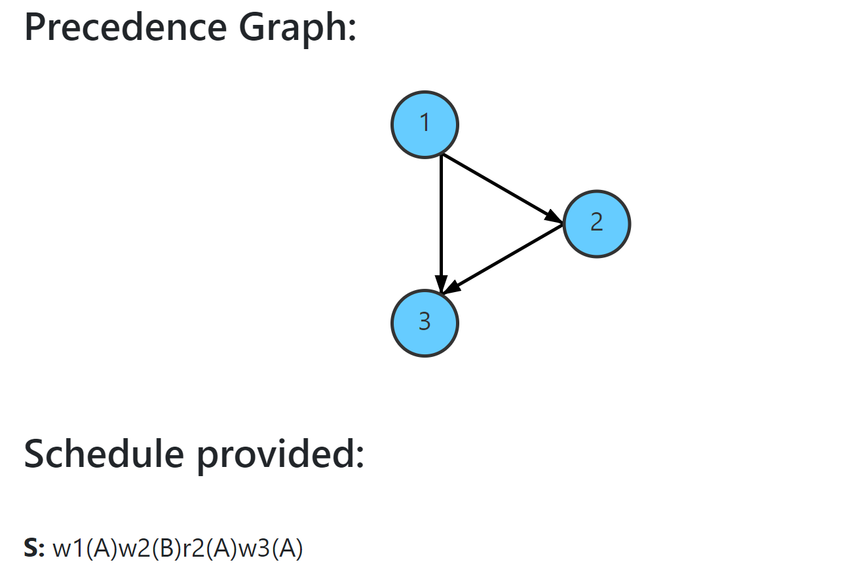
Compute the Precedence Graph
Given a schedule S on T1,…,Tn, the precedence graph P(S) associated to S is defined as follows:
the nodes of P(S) are the transactions {T1,…, Tn} of S
the edges E of P(S) are as follows: the edge Ti -> Tj is in E if and only if there exists two actions Pi(A), Qj(A) of different transactions Ti and Tj in S operating on the same object A such that:
Pi(A) appears before Qj(A) in S.
at least one between Pi(A) and Qj(A) is a write operation.

Slide 7
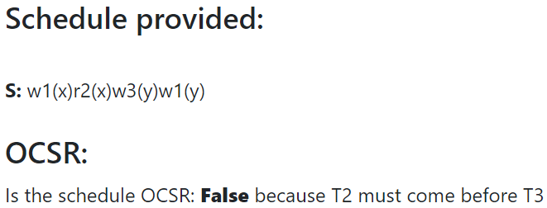
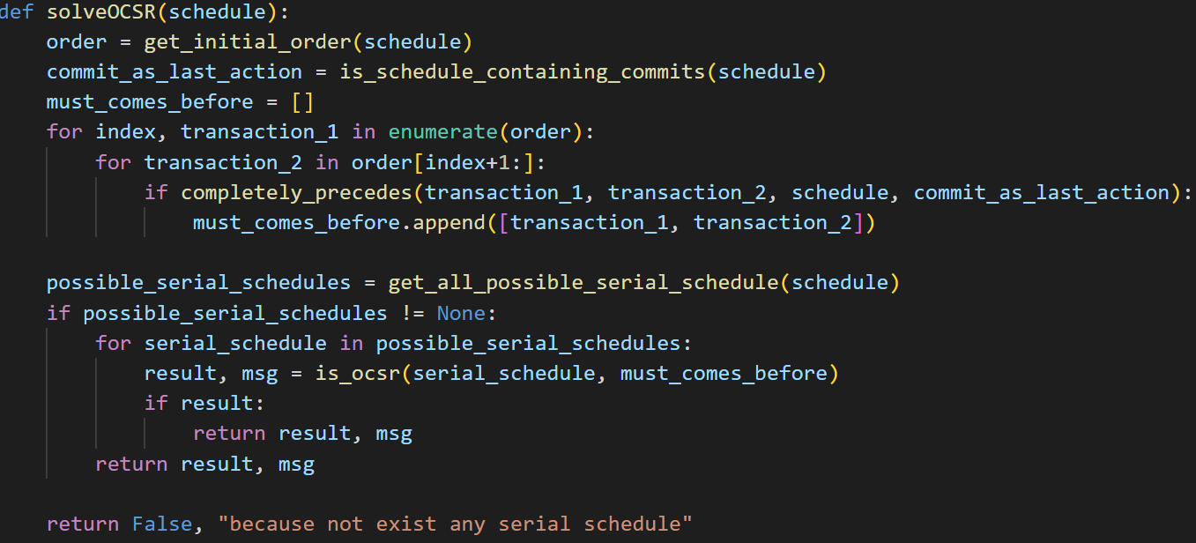
Checker for Order Preserving Conflict Serializable (OCSR)
Definition of OCSR for schedules:
A schedule S is order preserving conflict serializable if it is conflict equivalent to a serial schedule S’ and for all t, t’ ∈ tran(S): if t completely precedes t’ in S, then the same holds in S’.
Algorithm:
1 - check if there exists a serial schedule S’ that is conflict equivalent to S.
2 - If S’ exists, then calculate the order of transaction that this serial schedule should follow.
3 - If the order is respected by the serial schedule, then, S is OCSR.

Slide 8
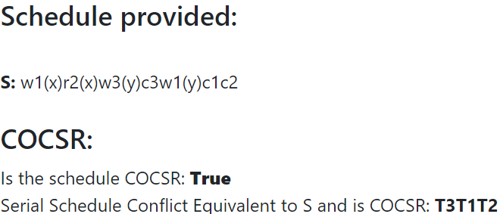
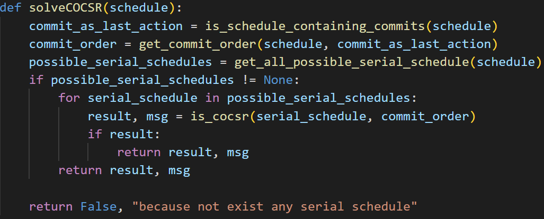
Checker for Commit Order Preserving Conflict Serializable (COCSR)
Definition of COCSR for schedules:
A schedule S is commit order preserving conflict serializable if there is a serial schedule S’ conflict equivalent to S such that for
∀ t_{i}, t_{j} ∈ tran(S), t_{i} precedes t_{j} in S’ if and only if c_{i} precedes c_{j} in S.
Algorithm:
1 - check if there exists a serial schedule S’ that is conflict equivalent to S.
2 - If S’ exists, then calculate the order of transaction that this serial schedule should follow.
3 - If the order is respected by the serial schedule, then, S is COCSR.

Slide 9
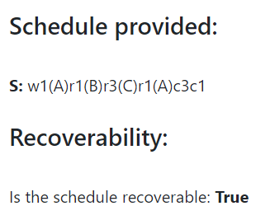
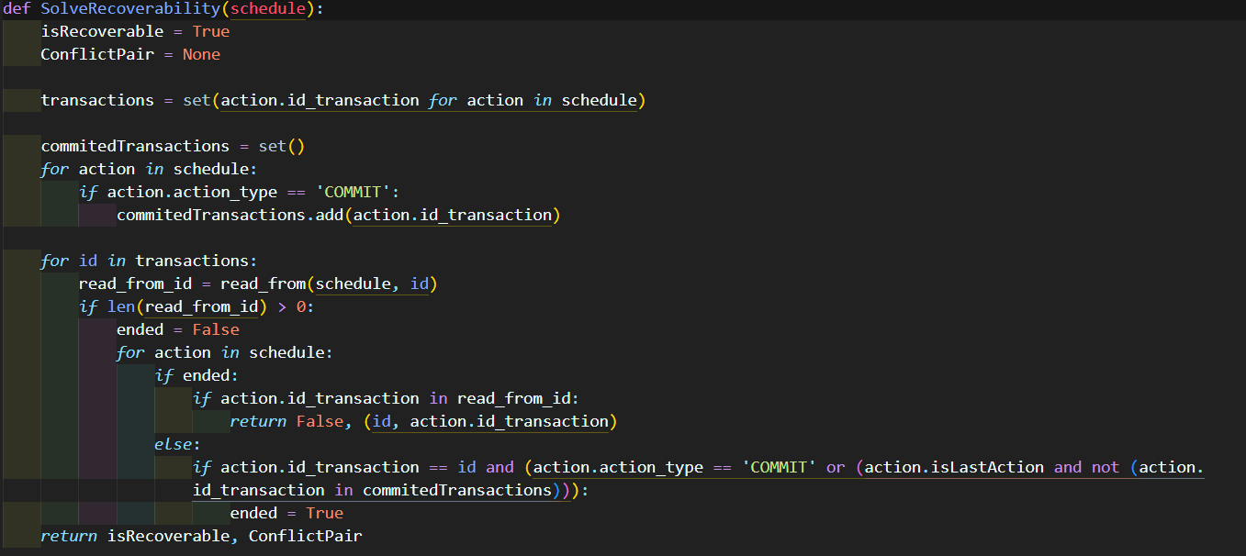
Checker for Recoverability
Definition of recoverability:
A schedule S is recoverable if no transaction in S commits before all other transactions it has “read from”, commit.
Algorithm:
1 - For each transaction calculate his read-from.
2 - For each transaction check when end, and check if after there is an action of a transaction that it has read-from.
3 - If such action exist return False and the pair, otherwise return True.

Slide 10
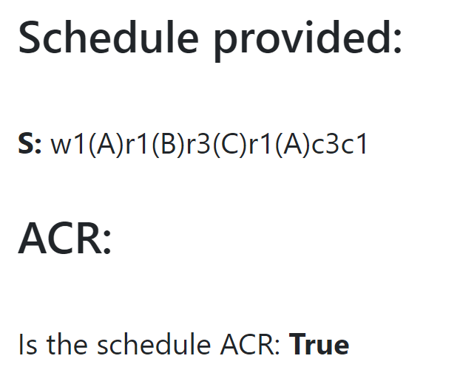
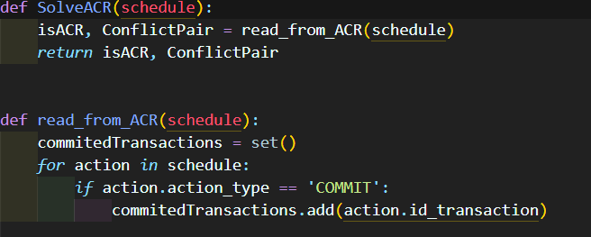
Checker for Avoid Cascading Rollback (ACR)
Definition of ACR:
A schedule S avoids cascading rollback (i.e., the schedule is ACR, Avoid Cascading Rollback) if every transaction in S reads values that are written by transactions that have already committed.
Algorithm:
1 - For each write action check when transaction commit.
2 - If there is a read on that write before commit, then return False.
3 - If for all write this not happen, then return True.

Slide 11
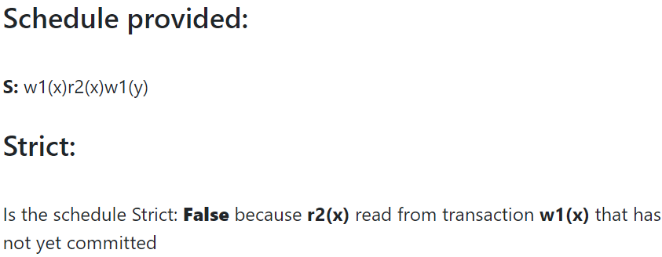
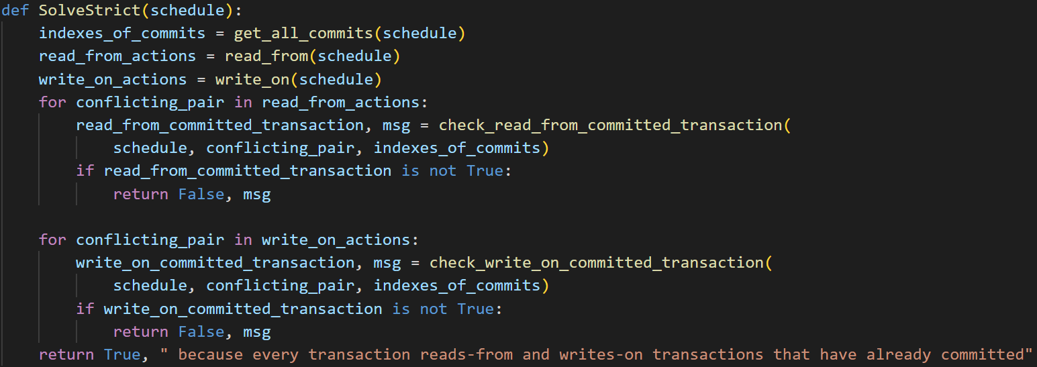
Checker for Strictness
Definition of Strictness for schedules:
A schedule S is strict if every transaction reads only from transactions that have already committed, and writes only on transactions that have already committed.
Algorithm:
1 - get all conflicting action of the type read-from and write-on
2 - check if all read-from actions reads from a committed transaction
3 - check if all write-on actions writes on committed transaction
4 - If both checks are passed successfully, then the schedule is Strict

Slide 12
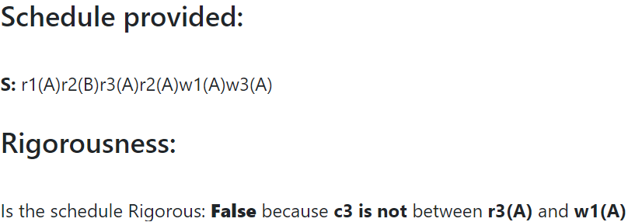
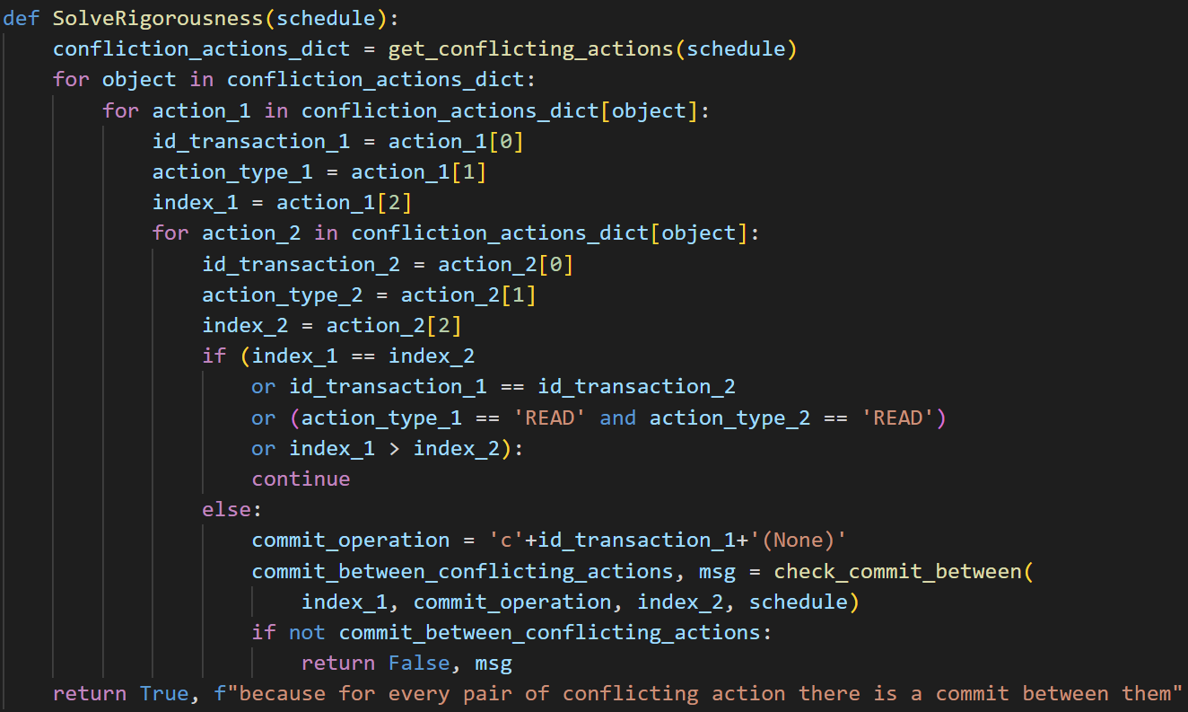
Checker for Rigorousness
Definition of Rigorousness for schedules:
A schedule S is rigorous if for each pair of conflicting actions a_{i} (of T_{i}) and b_{j} (of T_{j}) in S, the commit command c_{i} of T_{i} appears in S between a_{i} and b_{j}
Algorithm:
1 - get all conflicting action
2 - check if for all conflicting action there is a commit between the two actions
3 - If all checks are passed successfully, then the schedule is Rigorous

Slide 13
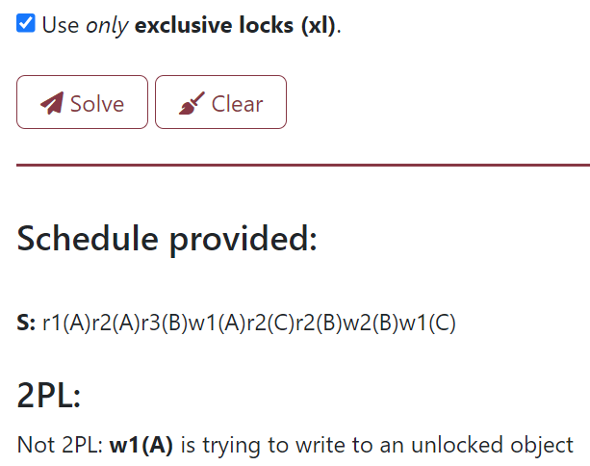
Checker for Two-Phase Locking (2PL, S2PL and SS2PL)
Definition of 2PL protocol for schedules:
A schedule follows the 2PL protocol if in every transaction T_{i} of S, all lock operations (exclusive or shared) precede all unlocking operations of T_{i}.
Definition of S2PL protocol for schedules:
A schedule S is S2PL if it follows the 2PL protocol, and all exclusive locks of every transaction T are kept by T until either T commits or rollbacks.
Definition of SS2PL protocol for schedules:
A schedule S is SS2PL if it follows the 2PL protocol, and all locks (both exclusive and shared) of every transaction T are kept by T until either T commits or rollbacks.

Slide 14
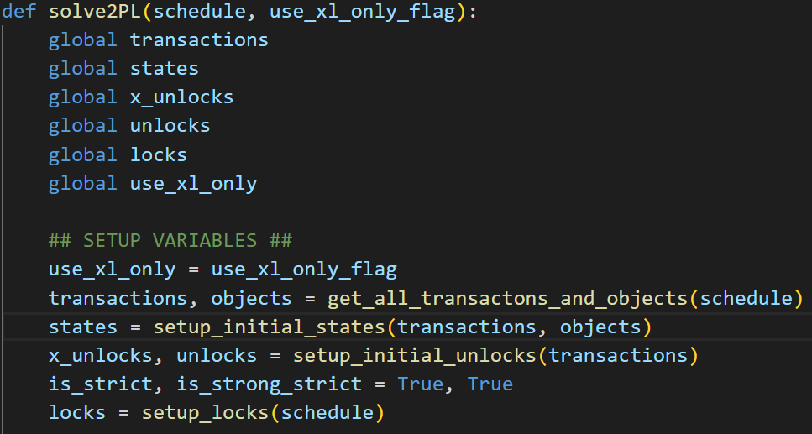
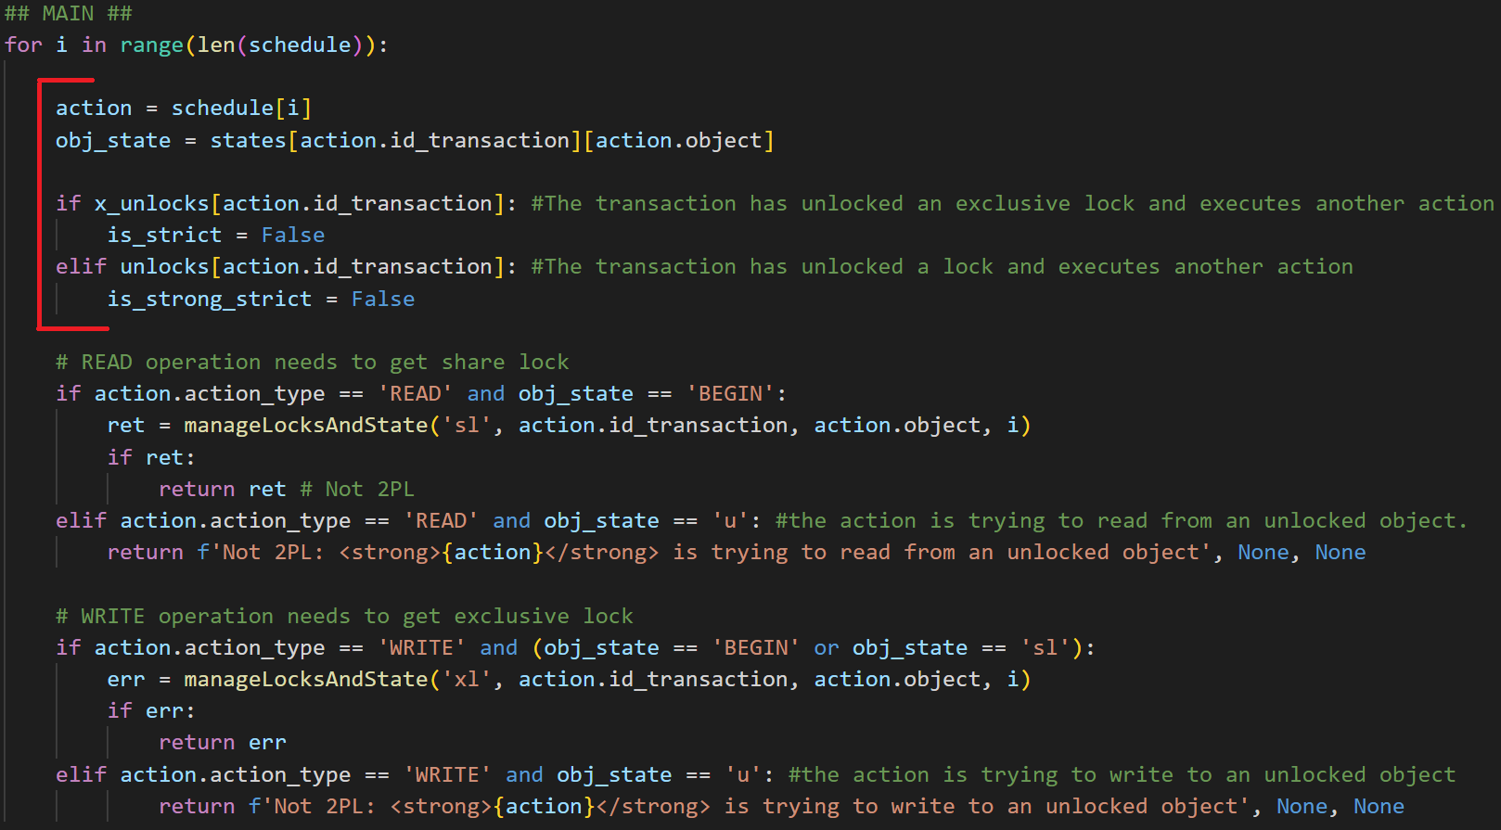
Checker for Two-Phase Locking (2PL, S2PL and SS2PL)
Algorithm (1):
1 - setup all variables that we will use in order to take track of state and locks/unlocks of object by transactions
2 - for each action, we check if the transaction has unlocked an exclusive lock and execute another action (checker for S2PL)
3 - for each action, we check if the transaction has unlocked any type of lock and execute another action (checker for SS2PL)
Step 1
Step 2-3

Slide 15
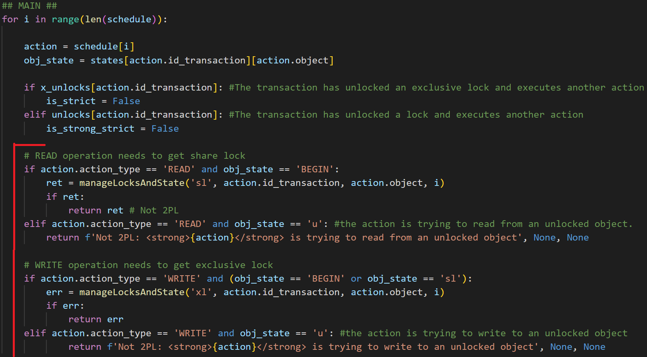
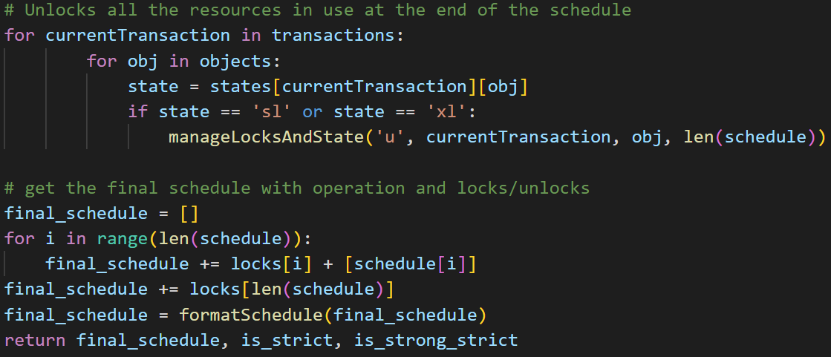
Checker for Two-Phase Locking (2PL, S2PL and SS2PL)
Algorithm (2):
4 - for each action, if it is a ‘READ’ or ‘WRITE’ operation, we should acquire the a defined type of lock (also future locks). So we check if it is possible to change the state of an object used by transaction to state sl (if the action type is read) or to state xl (if the action type is write)
5 - then, if the change of state is feasible from the point of view of the 2PL protocol, we add the corresponding lock/unlock actions to solution list and we move on to the next action
6 - After having processed the entire schedule, unlock all the resources in use at the end of the schedule and compute the final schedule composed by all the action and locks/unlocks
Step 4-5
Step 6

Slide 16
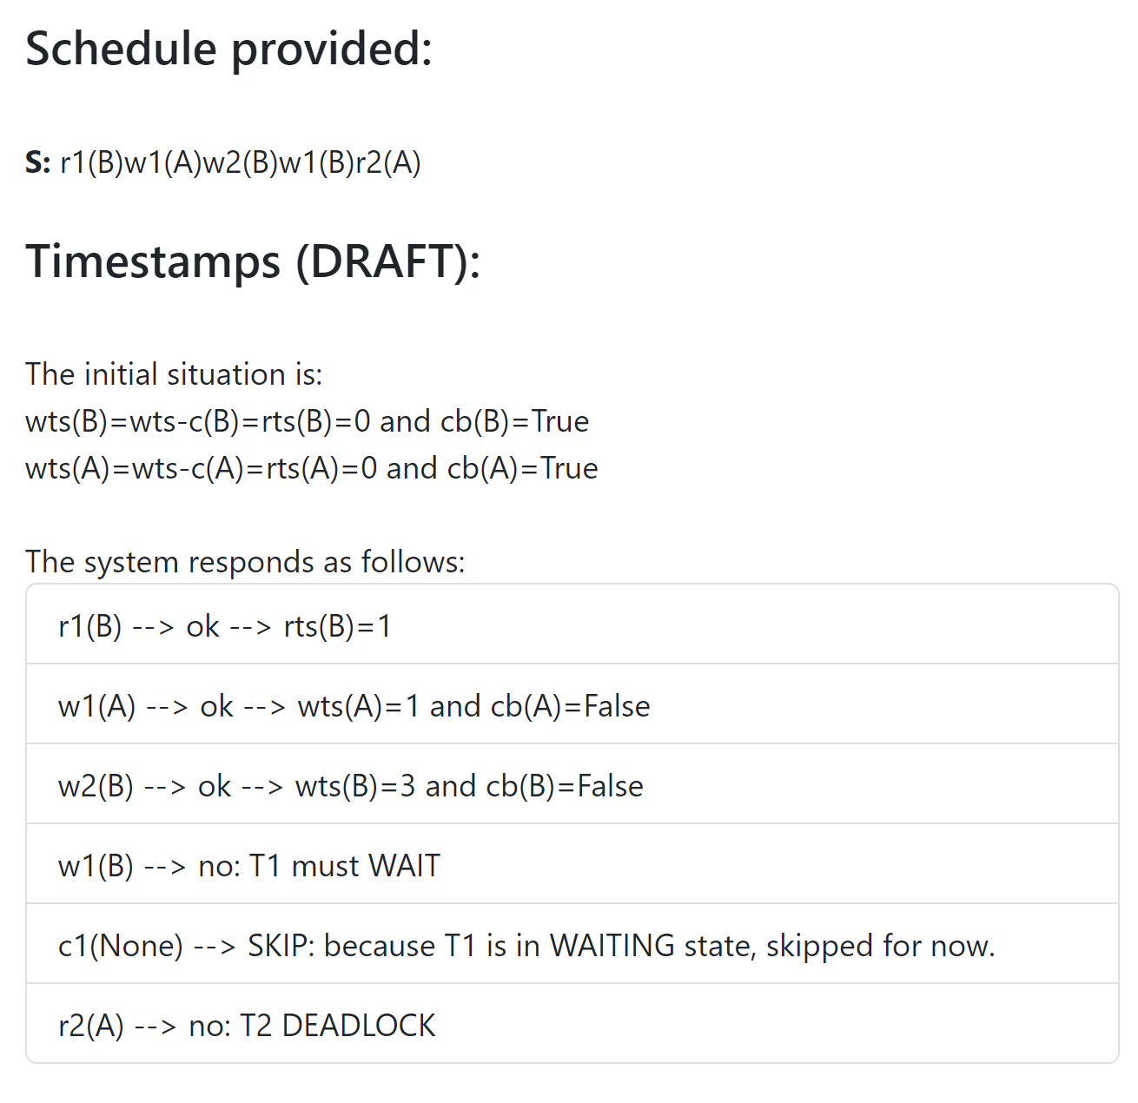
Checker for concurrency control through timestamps
Transactions execute without any need of protocols.
The basic idea is that, at each action execution, the scheduler checks whether the involved timestamps violates the serializability condition according to the order induced by the timestamps.

Slide 17
Final Product
The working product can be reached on this link:
https://transaction-checker-sie6.onrender.com/

Slide 18
Faculty of Information engineering, Informatics and Statistics, Engineering in computer science, University of Rome Sapienza, Academic year 2022-2023 Andrea Panceri 1884749 Francesco Sudoso 1808353
Thanks for the attention!
Project type 1 of Data Management
Schedule Checker for concurrency control
Prof. Maurizio Lenzerini
Tutor Roberto Delfino
Prof. Giovanni Farina
Notes:
‹#›

